Slide 1

Customer Shopping Behavior Analysis
Uncovering insights from 3,900 purchases to drive strategic decisions

Slide 2
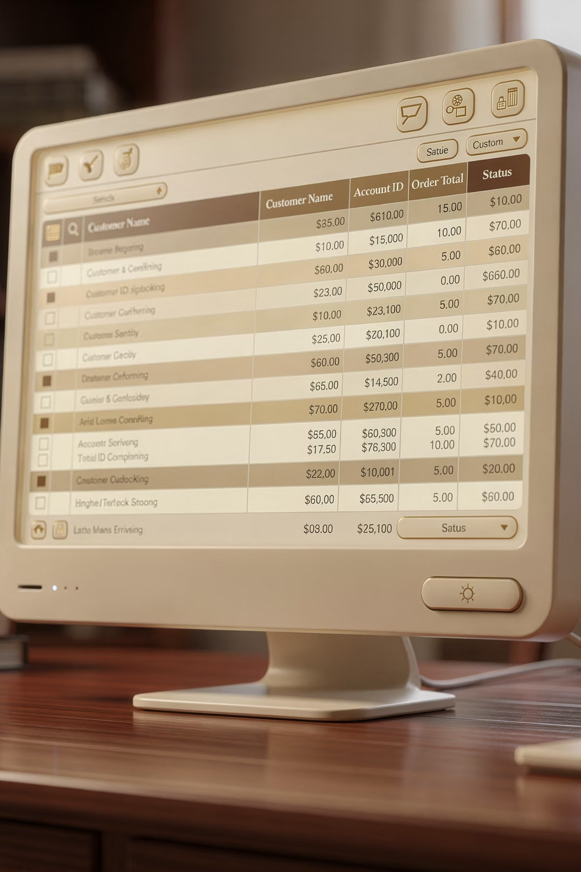
DATASET OVERVIEW
The Foundation
3.9K
18
50
Total Purchases
Data Points
Locations
Transactions analyzed
Features per customer
Geographic coverage
Demographics, purchase details, shopping behavior, and subscription status tracked across all transactions

Slide 3
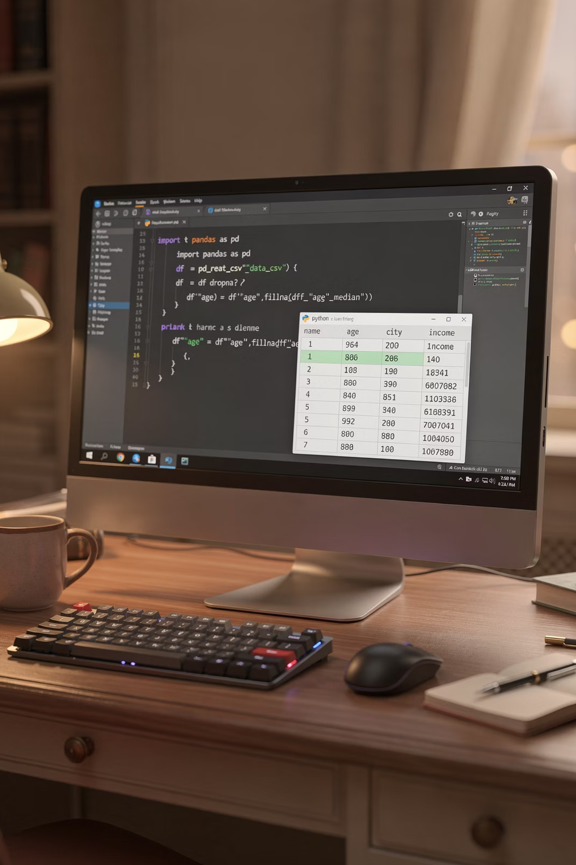
PYTHON ANALYSIS
Data Preparation & Cleaning
01
Data Loading
Imported dataset using pandas, explored structure with .info() and .describe()
02
Missing Data
Imputed 37 missing Review Ratings using median by category
03
Feature Engineering
Created age_group bins and purchase_frequency_days columns
04
Database Integration
Connected to PostgreSQL for advanced SQL analysis

Slide 4
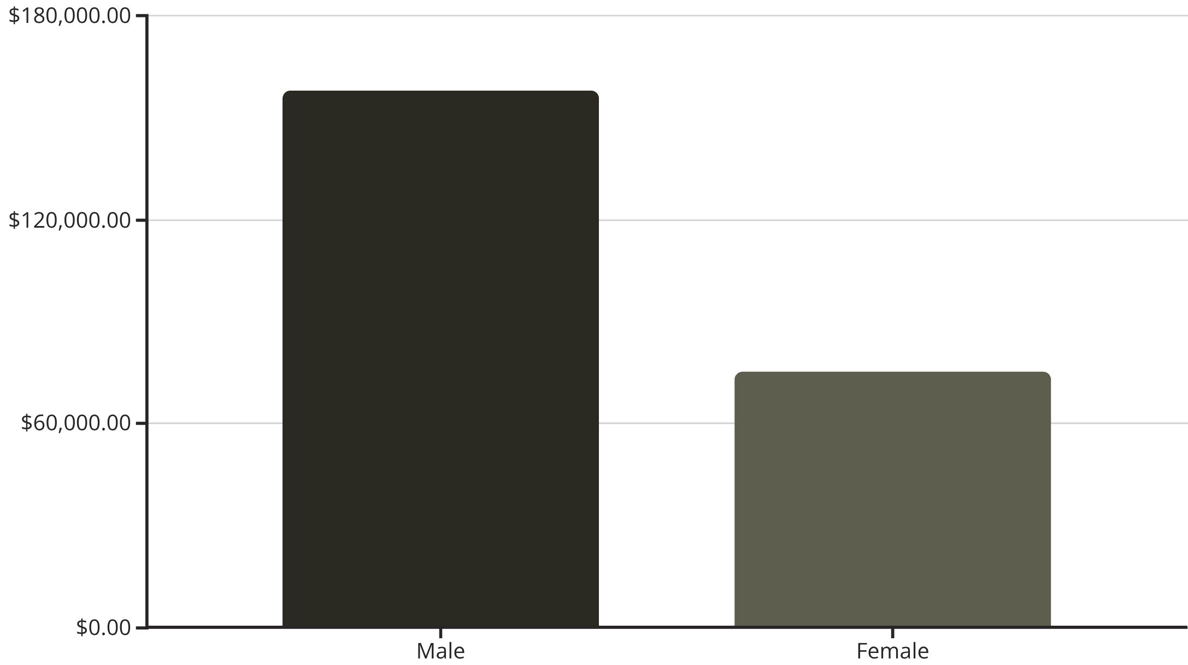
SQL INSIGHTS
Revenue & Customer Patterns
Key Findings
Male customers generate 2x revenue vs. female customers
839 discount users spent above average purchase amount
Express shipping correlates with $2 higher average spend
Top-rated products: Gloves (3.86), Sandals (3.84), Boots (3.82)

Slide 5


Subscription Impact Analysis
27%
73%
Subscribers
Non-Subscribers
1,053 customers
2,847 customers
Subscribers
Non-Subscribers
Avg: $59.49
Avg: $59.87
Total: $62,645
Total: $170,436

Slide 6

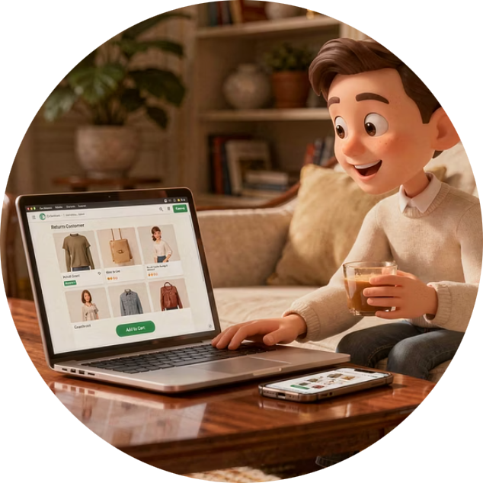

CUSTOMER SEGMENTS
Loyalty Distribution
Loyal
Returning
New
3,116 customers
701 customers
83 customers
Frequent purchasers driving core revenue
Growth opportunity segment
Fresh acquisition potential
958 repeat buyers (>5 purchases) show higher subscription rates

Slide 7

Power BI Dashboard
Real-Time Metrics
Category Performance
Age Group Insights
3.9K customers, $59.76 avg purchase, 3.75 rating
Clothing leads with $100K revenue, 2K sales
Young Adults generate highest revenue at $62K

Slide 8

RECOMMENDATIONS
Strategic Action Plan
Boost Subscriptions
Loyalty Programs
Discount Strategy
Promote exclusive benefits to convert 73% non-subscribers
Reward repeat buyers to grow 3,116 loyal customers
Balance sales boosts with margin control for 839 high spenders
Targeted Marketing
Product Positioning
Focus on Young Adults and express-shipping users
Highlight top-rated items: Gloves, Sandals, Boots

